Slide 1

PGConf US 2015
Building a ‘Database of Things’
With Foreign Data Wrappers
Rick Otten
Director, Data Science and Engineering
rotten@geardigital.com

Slide 2
The Internet of Things – IoT
Gartner Research: “IoT product and service suppliers will generate incremental revenue exceeding $300 billion, mostly in services, in 2020. It will result in $1.9 trillion in global economic value-add through sales into diverse end markets.” — (December 2013)
http://www.gartner.com/newsroom/id/2636073
Cisco Systems Inc. Chief Executive Officer John Chambers said that the Internet of Everything — connected products ranging from cars to household goods — could be a $19 trillion opportunity. (January 2014)
http://www.bloomberg.com/news/articles/2014-01-08/cisco-ceo-pegs-internet-of-things-as-19-trillion-market
Tim O’Reilly: “Silicon Valley is massively underestimating the impact of IoT” … “they aren’t thinking about systems.” — (March 4, 2015)
http://venturebeat.com/2015/03/04/tim-oreilly-silicon-valley-is-massively-underestimating-the-impact-of-iot-interview/
“While these open-source projects and alliances try to figure out how to standardize device-to-device communication protocols and data platforms, some think a consensus is unlikely.” — (February 2015)
http://www.fastcompany.com/3041698/googles-secret-weapon-in-the-battle-for-the-internet-of-things-academia

Slide 3
Foreign Data Wrappers Things Multicorn Philips Hue

Slide 4
Foreign Data Wrappers

Slide 5
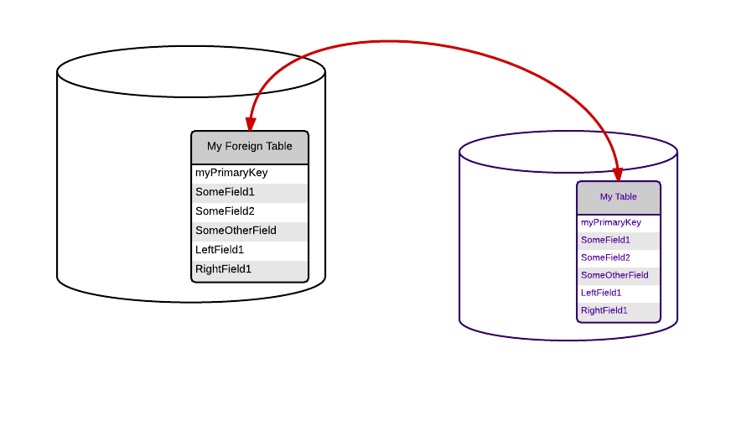
Foreign Data Wrappers
Share Data From One Database Into Another – Without having to actually copy the data!
SQL/MED SQL:2003
( ISO/IEC 9075-9:2003 )
Basic SQL/MED — PostgreSQL 8.4
(July 2009)
Select — PostgreSQL 9.1
(September 2011)
Writable — PostgreSQL 9.3
(September 2013)

Slide 6
Foreign Data Wrappers
Supports Many Databases
SQL DATABASES
PostgreSQL
Oracle
MySQL
Informix
Firebird
SQLite
ODBC
JDBC
NoSQL Databases
Tycoon
Hadoop
Hive
MonetDB
CouchDB
MongoDB
Neo4j
Redis
RethinkDB
Connectors
ODBC
JDBC
SQLAlchemy
And more …

Slide 7
Foreign Data Wrappers
Supports “other” data sources too
SAP (via “VirtDB”)
CitusData Columnar Store
CSV
LDAP
JSON
S3
Twitter
Web Pages (“www_fdw”)
Files and File systems (several implementations)
IMAP
Google
git
XML
RSS
“Black Hole” (/dev/null)
https://wiki.postgresql.org/wiki/Foreign_data_wrapper

Slide 8
Foreign Data Wrappers
How to use one
Set up a user on the foreign database with the relevant access permissions.
Install the extension on the local database:
create extension postgres_fdw;
Create a “server” (on the local database):
create server OtherDBServer foreign data wrapper postgres_fdw options (host ‘otherdbhost’, dbname ‘otherdb’);
Create a “user mapping”:
create user mapping for public server OtherDBServer options (user ‘somebody’, password ‘secretstuff’);
Create each Foreign Table:
create foreign table myschema.mytable
( …columns… )
server OtherDBServer options (schema_name ‘otherschema’, table_name ‘othertable’);

Slide 9
Foreign Data Wrappers
Almost like real tables … except
Can’t put indices or constraints on them
Most graphical clients can’t see them!
Use Views or the command line:
things-# \det
List of foreign tables
things-# \dew
List of foreign-data wrappers
things-# \des
List of foreign servers
things-# \deu
List of user mappings

Slide 10
Foreign Data Wrappers
Rules of Thumb for when NOT to use them
Copy data when:
Aggregating many small data sources into one
Query performance on remote systems is a concern
Making many small queries often
Intermittent, High Latency, or Slow Network connections
Using technology such as:
Synchronous or Streaming Replication
Bidirectional Replication (BDR) ( https://wiki.postgresql.org/wiki/BDR_User_Guide )
SymmetricDS ( http://symmetricds.org )
Batch jobs
Materialized views on top of Foreign Tables
( Concurrent Refresh in 9.4! ☺ )

Slide 11
Things

Slide 12

Things
The Internet of Things
Fridge: Current Temperature? Compressor On? Door Open?
Lights: On? Color? Brightness?
Robot Vacuum: Location? On? Bag status?
Home Thermostat: Furnace running? Current Temperature? Set Temperature? Schedule?
Garage Door: Open? Last Open Time?
Coffee Pot: How much Coffee is left? When was it last brewed?
Your car, your toaster, your electric space heater, your oven, home alarm system, and more…
Notes:
Bruce Munro art exhibit from Franklin Park Conservatory, Columbus OH, March 2014. (photo by Rick Otten)

Slide 13
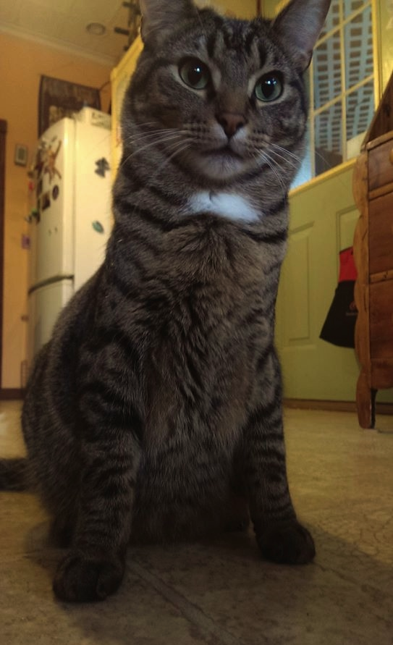
Things
The Internet of Things
Things have Identifiers
Things have State
Some things have mutable State
Things are data
refrigerators
id | description | compressor | door | temperature
1 | kitchen fridge | on | closed | 40
2 | beer fridge | off | closed | 48
3 | basement freezer | off | open | 28
A Table!
Notes:
Our cat “Stormy”

Slide 14
Things
Why a “Database of Things”?
Well-known and widely-supported interface
Consistent interface across things
Discover patterns in the current state of large sets of things
Join with Reference Tables and Maintenance Logs, and other data
What are the GPS coordinates where Thing 1 was installed, who installed it, and when?
When were the belts last changed on Thing 1?
Join and Union with each other
Build Frankenstein thing monsters
If you can’t beat them, join them!
Triggers! (PostgreSQL 9.4)
For turning the light on in the kitchen whenever the garage door is opened, or logging events

Slide 15

Multicorn

Slide 16
Multicorn
http://multicorn.org
https://github.com/Kozea/Multicorn
Python framework for building Foreign Data Wrappers
Inherit a new class from multicorn.ForeignDataWrapper.
Then you build Functions to implement these Database Functions:
SELECT
UPDATE
INSERT
DELETE
Rollback
Commit
Everything else takes place in the database (or in Multicorn).

Slide 17
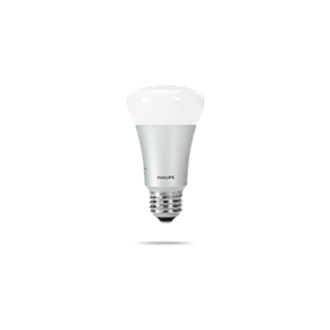

Phillips Hue Systems
http://www.meethue.com
Developer Friendly Documentation and Forum
http://www.developers.meethue.com
https://github.com/rotten/hue-multicorn-postgresql-fdw

Slide 18
Multicorn
create server myhuelights foreign data wrapper multicorn options
(wrapper 'hue_fdw.HueLightsFDW.HueLightsFDW',
bridge '192.168.0.101',
userName 'postgreshue',
transitionTime '1');
Inherit and set up a Class
class HueLightsFDW(ForeignDataWrapper):
"""
Philips Hue Lights Foreign Data Wrapper for PostgreSQL
"""
def __init__(self, options, columns):
if options.has_key('bridge'):
self.bridge = options['bridge']
else:
log_to_postgres('bridge IP address is required for Hue Lights setup.', ERROR)
if options.has_key('username'):
self.userName = options['username']
else:
self.userName = 'postgreshue'
log_to_postgres('Using Default Username for Hue Lights setup: postgreshue.', WARNING)

Slide 19
Multicorn
select
light_id, xy
from mylights
where is_on = true;
Execute (SELECT)
def execute(self, quals, columns):
For each light returned from the GET :
row = OrderedDict()
# add the requested columns to the output:
for column in columns:
operatorFunction = getOperatorFunction(qual.operator)
if not operatorFunction(row[qual.field_name], qual.value):
break
yield row

Slide 20
Multicorn
Execute (SELECT)
getOperatorFunction(qual.operator)
def getOperatorFunction(opr):
operatorFunctionMap = {
'<': operator.lt,
'>': operator.gt,
'<=': operator.le,
'>=': operator.ge,
'=': operator.eq,
'<>': operator.ne,
operatorFunction(row[qual.field_name], qual.value)

Slide 21
Multicorn
update mylights
set
is_on = true
where
light_id = 1;
UPDATE
self._row_id_column = 'light_id'
@property
def rowid_column(self):
return self._row_id_column
def update(self, lightID, newValues):
if newValues[changedColumn] == 't':
newState[self.columnKeyMap[changedColumn]] = True

Slide 22
Multicorn
Error logging & Troubleshooting
except Exception, e:
log_to_postgres('Unexpected (non-JSON) response from the Hue Bridge: %s' % self.bridge, ERROR)
log_to_postgres('%s' % e, ERROR)
log_to_postgres('%s' % results, ERROR)
log_to_postgres('Hue Lights Insert Request Ignored - not yet supported by API - requested values: %s' % new_values, WARNING)
log_to_postgres('Hue Lights Query Filters: %s' % quals, DEBUG)
ERROR — Halt Transaction
WARNING — Let the User know they are doing something unusual
DEBUG — Only show up when in DEBUG mode (to your log file)

Slide 23
Multicorn
Error logging & Troubleshooting continued
Python stack traces go to your log file.
To see DEBUG messages update your postgresql.conf and then pg_reload:
log_min_messages = debug1
** After deploying new code (python ./setup.py install) you do need to exit your database session and log back in to pick up the changes. You don’t need to restart the database. **

Slide 24
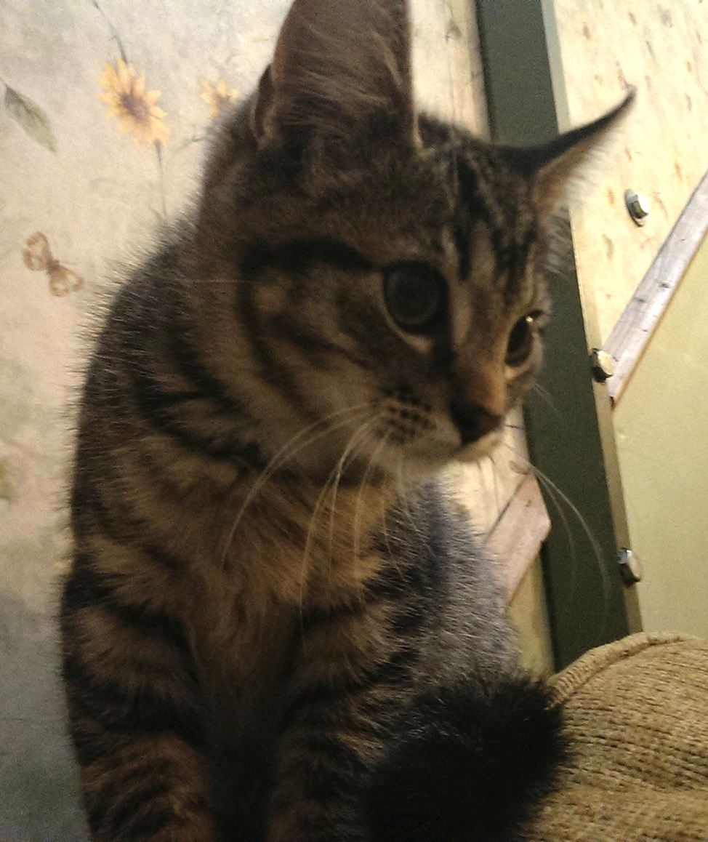
Setting Up The Philips Hue FDW
The ‘Lights FDW’
http://www.developers.meethue.com/documentation/getting-started
$ pgxn multicorn
$ git clone https://github.com/rotten/hue-multicorn-postgresql-fdw.git
$ cd hue-multicorn-postgresql-fdw
$ python ./setup.py install
ddl/setup_lights.ddl
Create extension
Create server
Create table
Notes:
Stormy when he was a kitten.

Slide 25
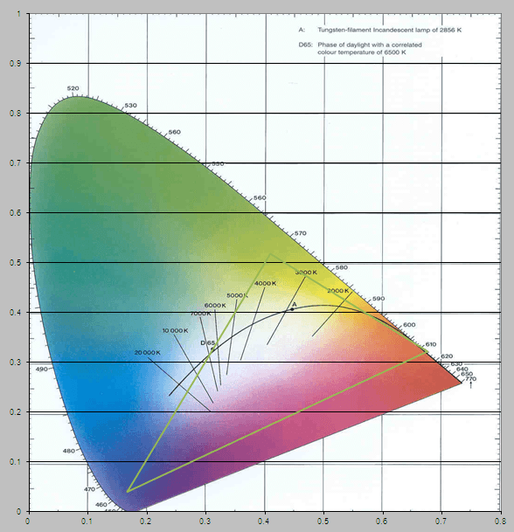
Colors
xy colors (CIE)
Color Temperature (Mired)
Hue, Saturation, & Brightness

Slide 26
Colors Reference Table
http://www.colorhexa.com/color-names
colors/html_colors_table.ddl
Using color names
create table html_colors
copy html_colors from '/some/path/to/html_colors_data.csv' with CSV HEADER
update mylights
set
xy = (select xy from html_colors where color_name = 'crimson red')
where
light_id = 1;
update mylights
set
hue = c.hue,
saturation = c.saturation,
brightness = c.brightness
from
(select hue, saturation, brightness from html_colors where color_name = 'crimson red') c
where
light_id = 1;

Slide 27
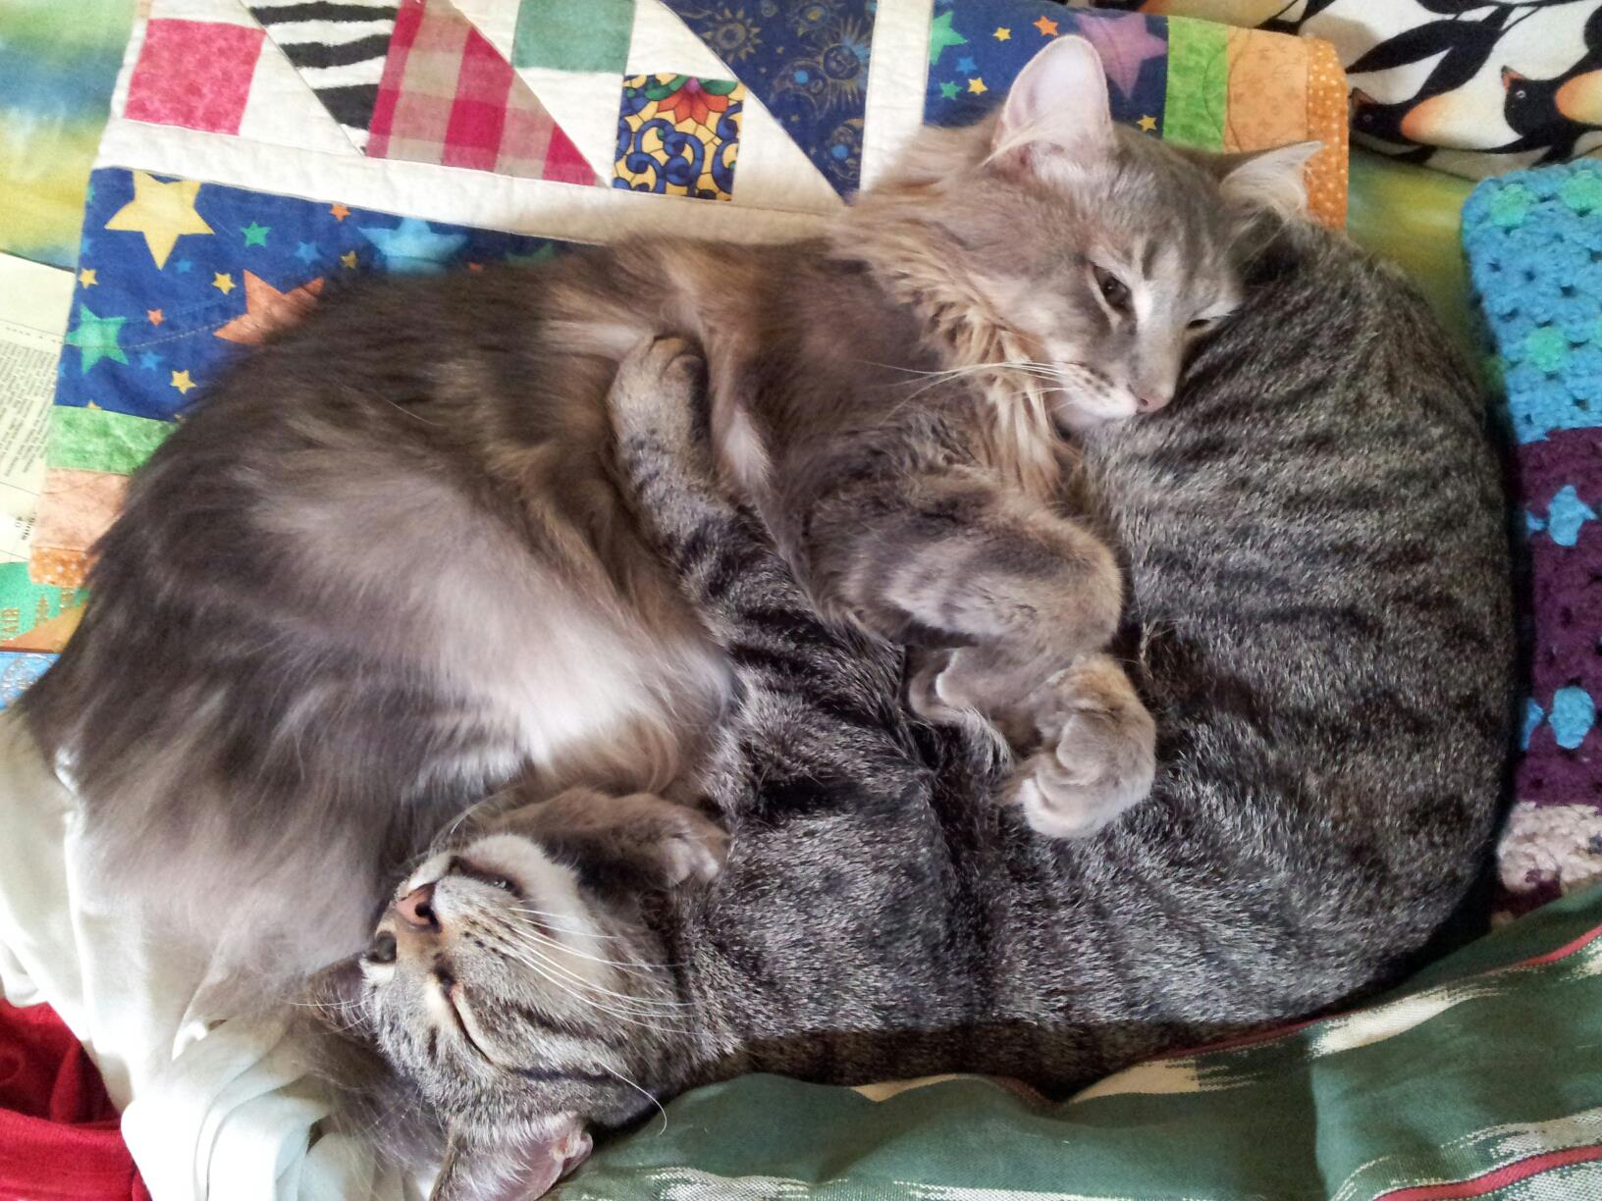
Mixing data and things
Blink on Donations
create table donors (
id uuid primary key default uuid_generate_v4(),
donate_time timestamp (6) with time zone default now(),
donor_name varchar,
donation numeric
);
create or replace function blink_a_light() returns trigger as $blink_it$
begin
if NEW.donation < 10.0 then
-- blink one light once if we get a small donation
update mylights set alert = 'select' where light_id = 1;
else
-- blink all the lights for 30 seconds if we get more then $10.
update mylights set alert = 'lselect';
end if;
return null;
end;
$blink_it$ LANGUAGE plpgsql;
create trigger donation_received
AFTER insert on donors
for each row execute procedure blink_a_light();
Notes:
Our cats Stormy and Robin

Slide 28
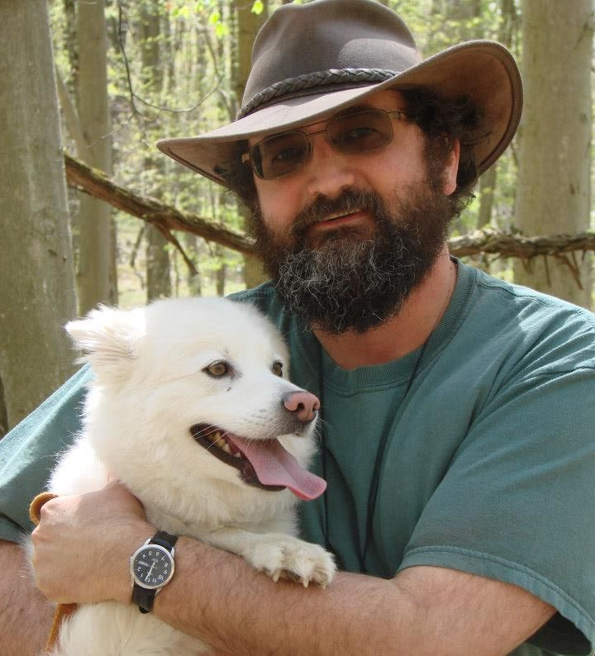

Thank You
Just some of the people who made this possible
Dustin Leggans
Dave Wilson
Jeff Casavant & Brian Hoover
The rest Of The gearDigital Team
The PG Conf Organizers, Volunteers, and Attendees
Catherine Saveson
Liam & Willow Otten
These slides can be found in the ‘extra’ directory of the rotten Philips Hue github repo.
https://github.com/rotten/hue-multicorn-postgresql-fdw
@rick_otten
rotten@gearDigital.com
Notes:
Our dog, Trip.

Slide 29

Thank you

Slide 30
Foreign Data Wrappers
Rules of Thumb for when NOT to use them
Use Functions when:
Doing something unique that doesn’t fit in a table or involves a lot of calculations.
Notes:
May just say this and not put it on a slide.

